Slide 1

SuperStore Sales & Marketing Analytics
Data-driven analysis of e-commerce sales to uncover trends, customer behavior, and actionable insights for business growth
Author: Bhawna Kumari | Tools: Python, Pandas, Matplotlib, Seaborn

Slide 2




Project Overview
Dataset Scale
Objective
25,035 orders across 10,292 unique products from 795 customers
Analyze sales and marketing data to drive profitability and customer retention
Key Focus Areas
Customer segmentation, regional performance, and discount effectiveness

Slide 3
Performance Snapshot
$12.6M
$1.47M
$505
100%
Total Sales
Total Profit
Average Order Value
Repeat Customers
Strong revenue generation across all categories
Healthy 11.62% profit margin
Exceptional retention across 795 customers
Consistent customer spending patterns
The business demonstrates strong customer loyalty with consistent order volume and healthy margins, positioning it well for sustainable growth.

Slide 4
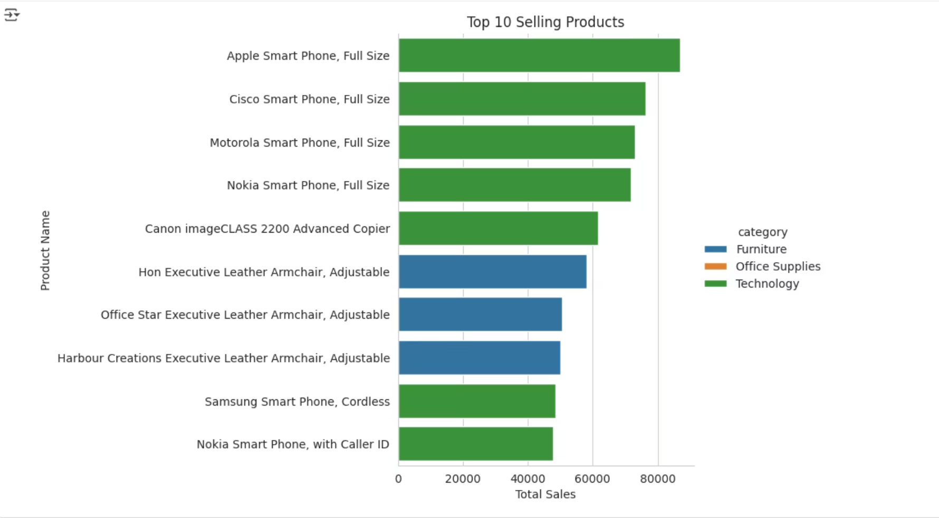
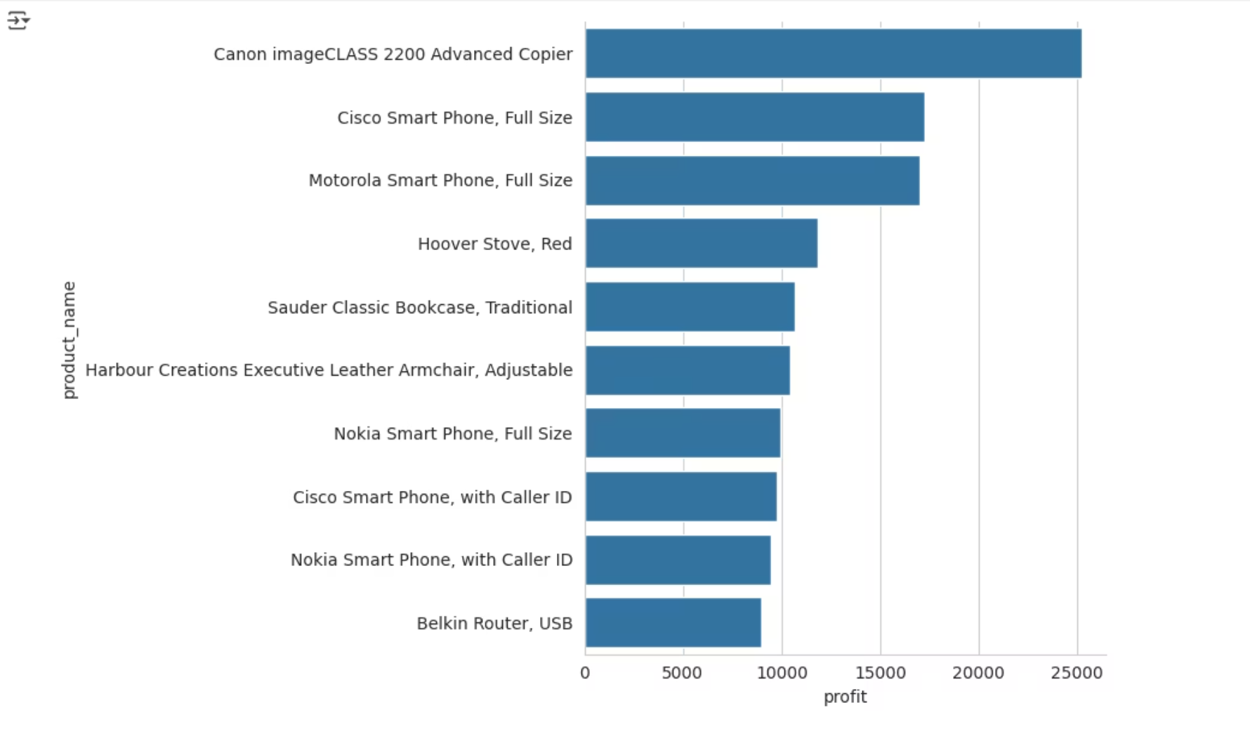
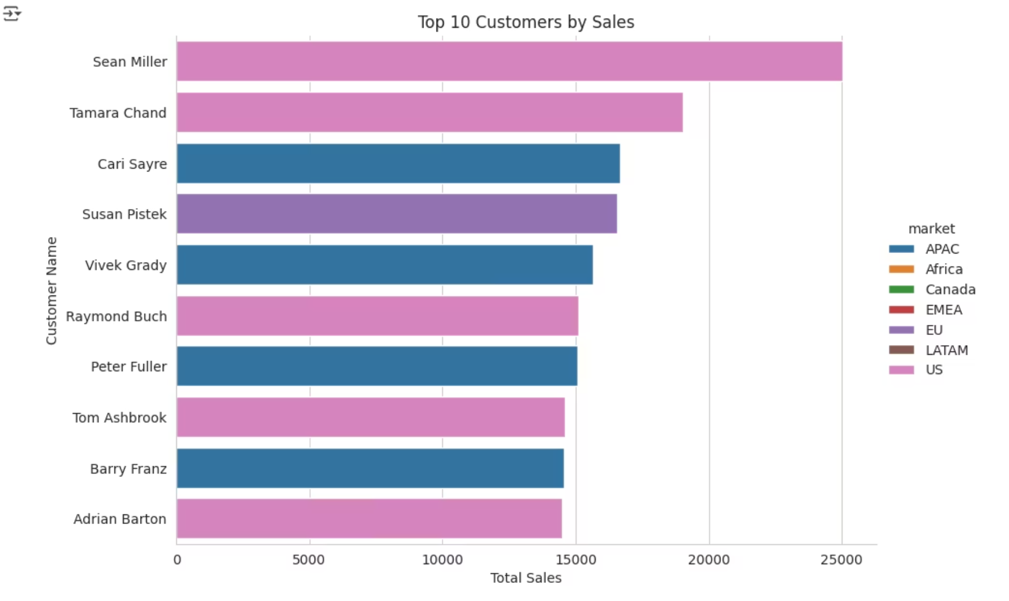
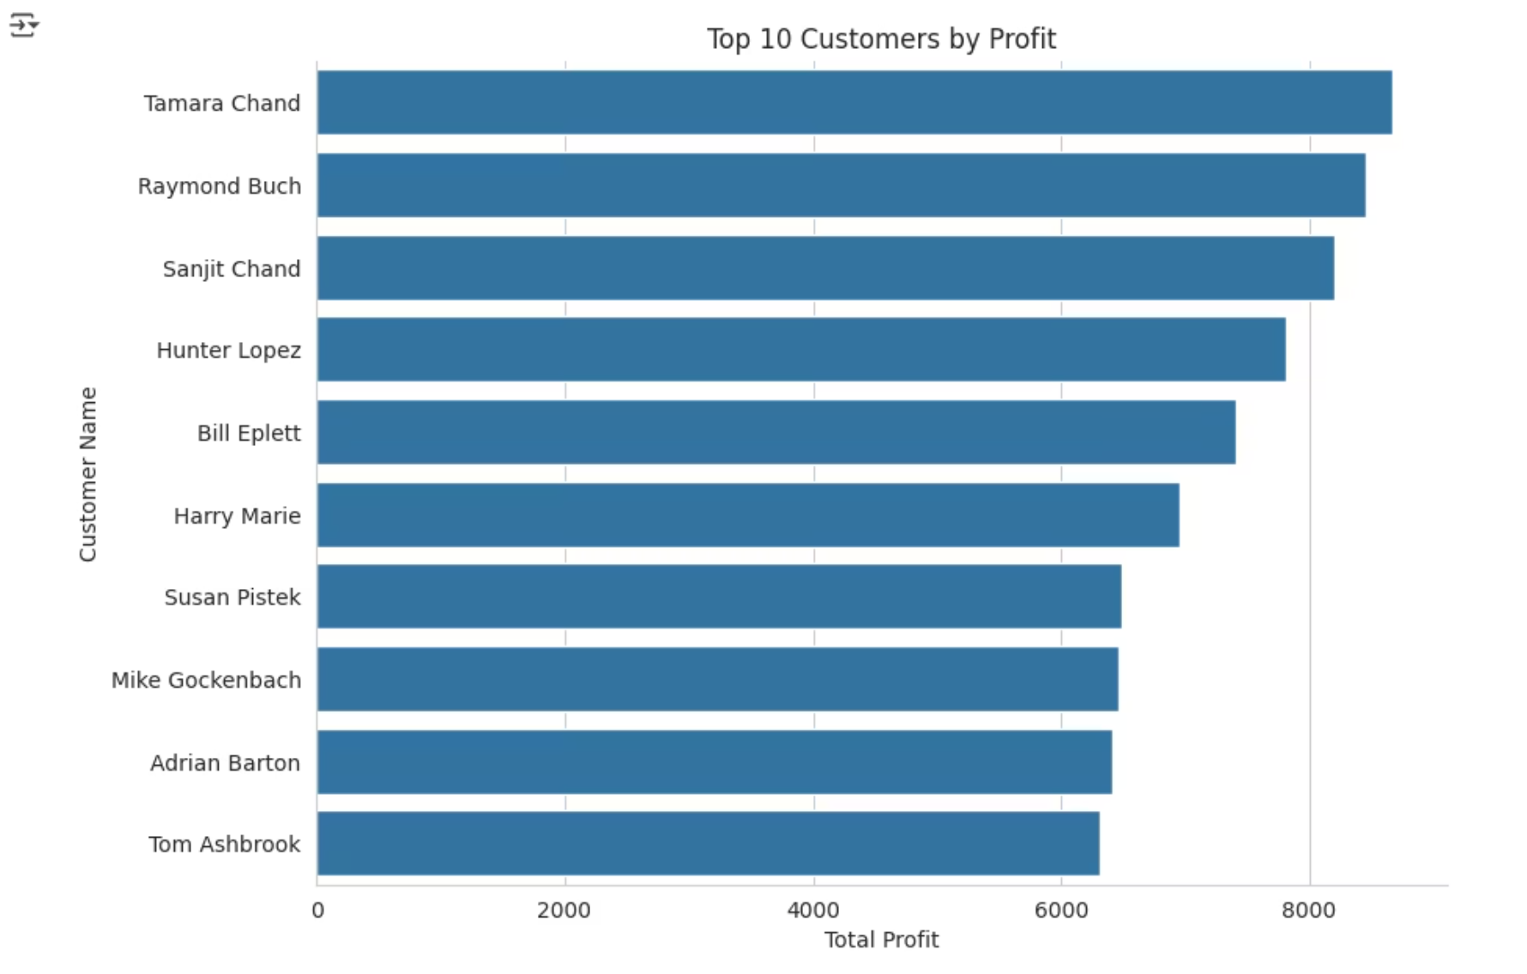
Top Performers
Best-Selling Products
Highest Profit Products
Apple Smart Phone leads in sales volume, dominated by Technology and Furniture categories
Canon imageCLASS 2200 Advanced Copier generates the highest profit margins
Top Customers by Sales
Most Profitable Customers
Sean Miller and Tamara Chand lead in total purchase volume
Tamara Chand and Raymond Buch drive highest profit contribution

Slide 5
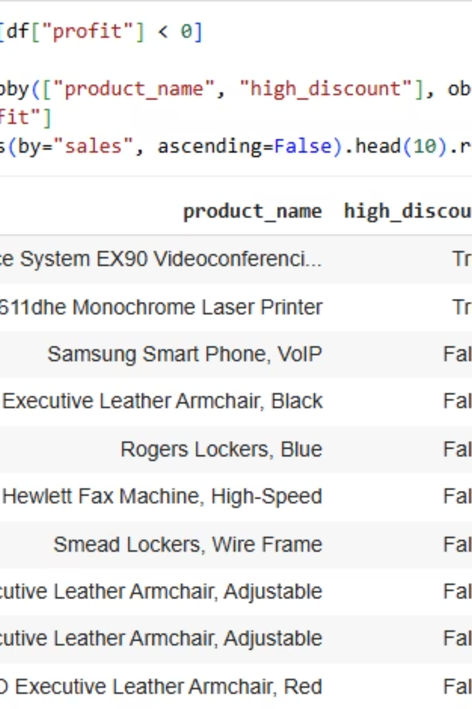

Loss-Making Products Require Attention
High-End Technology
Premium Printers
Cisco TelePresence System EX90 Videoconferencing Unit shows negative profits
Certain high-end printer models eroding margins despite sales volume
Furniture Items
Select furniture products require pricing and cost structure review
These products need immediate review for pricing optimization, discount adjustments, or supplier renegotiation to restore profitability.

Slide 6
Geographical Performance
Top Countries
Market Leaders
Regional Strength
USA leads, followed by Australia and France
APAC dominates, followed by EU and US markets
Central and South regions drive revenue growth
APAC and Central regions show strong international demand, indicating significant opportunities for targeted expansion and marketing investment.

Slide 7
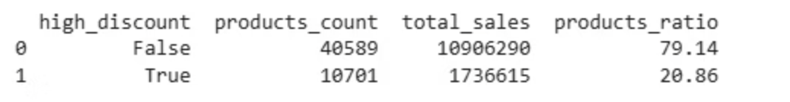



The Discount Dilemma
High Discounts = Profit Loss
30%
Critical Threshold
Discounts ≥30% lead to negative profit
20.86%
Products Affected
Over one-fifth of products heavily discounted
13.73%
Sales Impact
These discounts represent significant revenue
Over-discounting directly erodes profitability. Implementing stricter discount policies could significantly improve margins without sacrificing customer satisfaction.

Slide 8

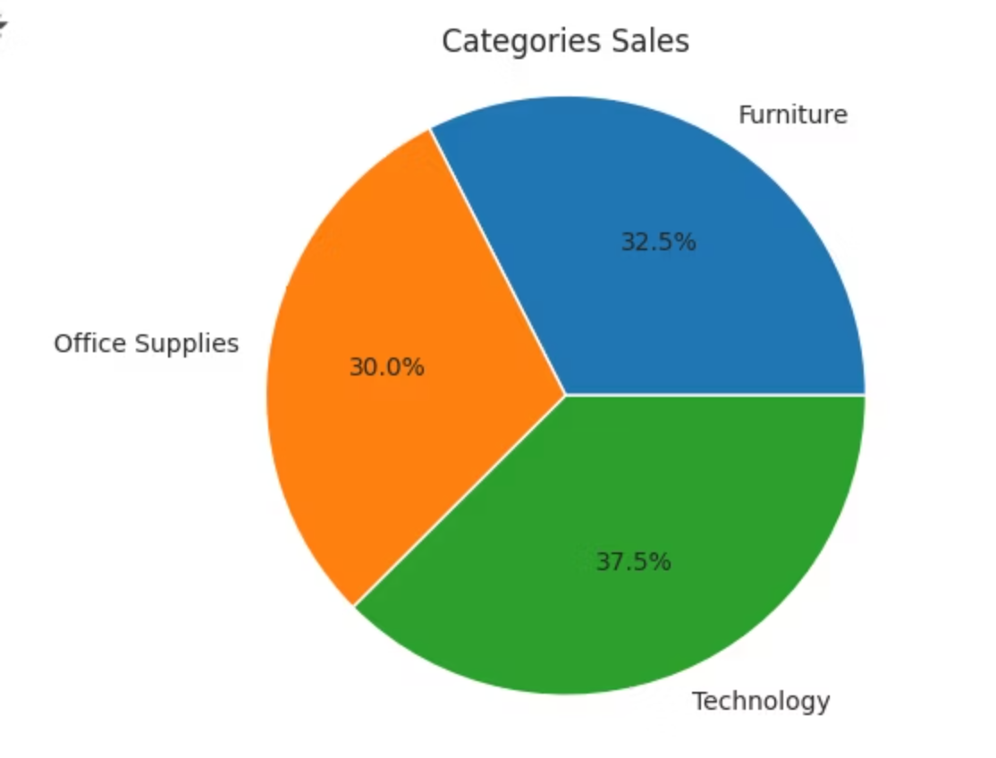
Category & Shipping Insights
Category Performance
Shipping Patterns
Technology leads in both sales and profit, followed by Furniture and Office Supplies. Top sub-categories include Phones, Copiers, and Chairs.
88.6% of sales occur on weekdays
Medium-speed shipping accounts for 59.4% of sales
Average delivery time: 3.97 days
Medium and fast deliveries correlate with higher profit margins

Slide 9
Strategic Recommendations
01
02
Optimize Discount Policy
Audit Unprofitable Products
Limit discounts above 30% to prevent profit erosion while maintaining competitive positioning
Reevaluate pricing and supplier agreements for loss-making items, especially high-end technology
03
04
Leverage Repeat Customers
Enhance Shipping Efficiency
Launch loyalty programs and personalized offers to capitalize on 100% retention rate
Focus on medium-speed deliveries for optimal ROI and customer satisfaction balance
05
06
Regional Marketing Focus
Expand Technology Category
Invest more in APAC and top-performing states to maximize growth potential
Promote and diversify top-performing tech SKUs as the key growth driver

Slide 10

Key Takeaways
Strong Foundation
Growth Opportunities
Exceptional customer retention (100%) and healthy profit margins (11.62%) demonstrate business strength
APAC market and Technology category show highest potential for expansion and investment
Immediate Actions
Optimize discount strategy and audit unprofitable products to boost margins significantly
Through targeted discount optimization, regional focus, and category management, SuperStore can transform strong sales performance into exceptional profitability while maintaining its outstanding customer loyalty.

